Slide 1
The Evolution of Software Systems

Slide 2
Agenda
Entropy of Software Systems – Refactor!
The Expanding Universe –Design Iteratively!
The Waterfall Model is an Illusion – Be Agile!
Black Holes Swallow All – Loose Coupling!

Slide 3
The Entropy of a Closed System
The second law of thermodynamics states that a closed system's disorder may remain unchanged or increase but not decrease.
A measure of this disorder is entropy.
The entropy of a system measures how much energy it has that is unavailable for work.
Entropy can be reduced by applying energy from outside the system.

Slide 4
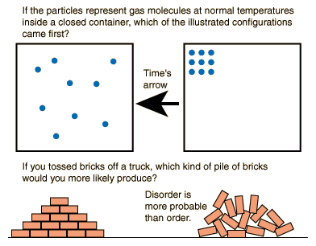
Disorder is More Probable

Slide 5
Lehman’s Laws (2 of 8)
Increasing Complexity — As software evolves its complexity increases unless work is done to maintain or reduce it
Declining Quality — The quality of software will appear to be declining unless they are rigorously maintained and adapted to environment changes

Slide 6
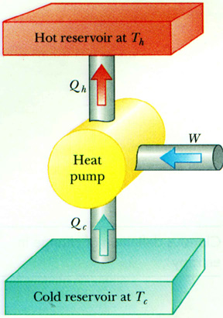
Heat Pump and Refrigerator
Heat Pumps and Refrigerators
Reversing the direction of heat transfer requires an investment of energy

Slide 7
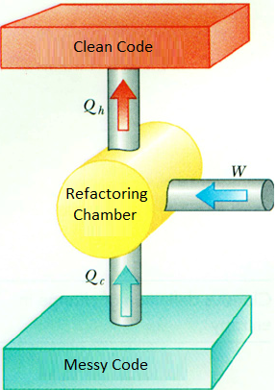
The Refactoring Process
Heat Pumps and Refrigerators
Reversing the direction of software decay requires an investment of energy

Slide 8
The Expanding Universe
Since the Big Bang, 13.7 billion years ago the universe is expanding
According to Hubble’s law the further away the object is the faster it is moving away.
There is no center all parts move away from each other according to this law.
There is no limit on how fast space can expand.
Notes:
http://www.space.com/52-the-expanding-universe-from-the-big-bang-to-today.html

Slide 9
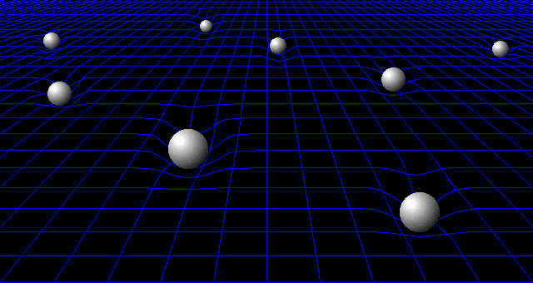
Rubber Sheet Analogy
Expansion is like balls on a rubber sheet

Slide 10
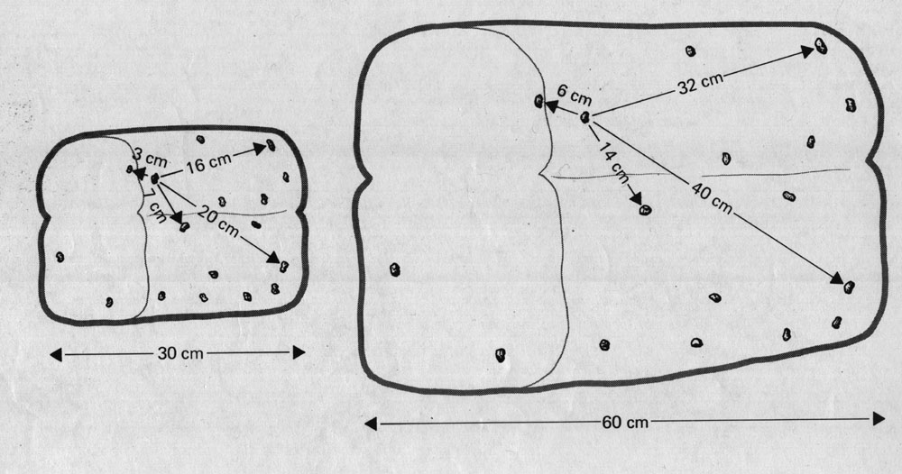
Raisin Bread Analogy

Slide 11
Requirements Expand Rapidly
The scope of responsibilities is like the fabric of the universe.
A cluster of raisins is a class encompassing a subset of the responsibilities.
As requirements become more complex, the fabric expands.
The same class now has responsibility over more functions.

Slide 12
Designs Must Be Revisited
The initial design may have few classes.
Developers tend to get stuck with a fixed view of the system.
After some time, each class has many responsibilities and thousands of lines of code.
Revisit and break out the design as complexity increases.

Slide 13
The Waterfall Model is an Illusion
It is impossible to predict how requirements will expand and evolve.
It is not possible to visualize or analyze the details of an implementation before implementation begins.
Be Agile: Design and implementation are iterative processes.

Slide 14
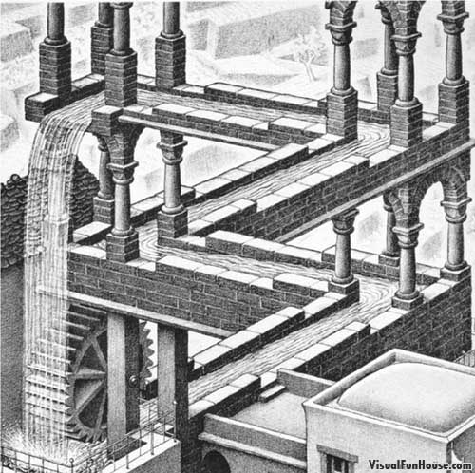

Escher's Waterfall Model Illusion

Slide 15
The End of a Star
A star may end its life as a White Dwarf, a Neutron Star or a Black Hole
Small stars (like our sun), end as White Dwarfs
Large stars (4-8 stellar mass), end as Neutron Stars
Very large stars (10-15 stellar mass) become Black Holes that suck in other objects and can grow to be millions solar masses

Slide 16

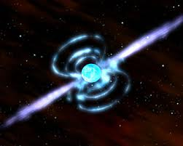
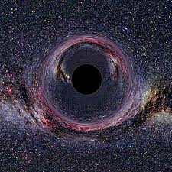
The End of a Star
Neutron Star
Black Hole
White Dwarf

Slide 17
Black Holes
A black hole is a region of space-time from which gravity prevents anything, including light, from escaping.
Black holes are caused by the gravitational collapse of large stars.
This occurs when an object's internal pressure is insufficient to resist the object's own gravity, typically when they burn out all their fuel.

Slide 18
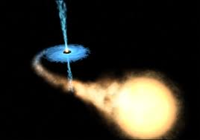
Black Holes Swallow All
A black hole that is gaining mass (accretion) from a star.

